Slide 1
Introduction to C Programming
Prof. Shrida Kalamkar
spk.comp@coep.ac.in

Slide 2
Programming Languages
Programmers write instructions in various programming languages, some directly understandable by computers and others requiring intermediate translation steps.

Slide 3
Levels of Programming Languages
Machine Languages
Any computer can directly understand only its own machine language, defined by its hardware architecture.
Machine languages generally consist of numbers (ultimately reduced to 1s and 0s). Such languages are cumbersome for humans.
Assembly Languages
Programming in machine language was simply too slow and tedious for most programmers.
Instead, they began using English like abbreviations to represent elementary operations.
These abbreviations formed the basis of assembly languages.
Translator programs called assemblers were developed to convert assembly-language programs to machine language.
Although assembly-language code is clearer to humans, it’s incomprehensible to computers until translated to machine language.
.

Slide 4
Levels of Programming Languages
High-Level Languages
To speed the programming process even further, high-level languages were developed in which single statements could be written to accomplish substantial tasks.
High-level languages allow you to write instructions that look almost like everyday English and contain commonly used mathematical expressions.
Translator programs called compilers or interpreters convert high-level language programs into machine language.
Compilers translate the entire program into machine language before executing any of the instructions.
Interpreters, on the other hand, proceed through a program by translating and then executing single instructions or small groups of instructions.
Every computer must have its own compiler or interpreter for a particular high-level language.

Slide 5
Levels of Programming Languages
High-level language
class Triangle {
...
float surface()
return b*h/2;
}
Assembly language
LOAD r1,b
LOAD r2,h
MUL r1,r2
DIV r1,#2
RET
Machine language
0001001001000101001001001110110010101101001...

Slide 6
What is Compiler in C?
A compiler is a computer program that transforms human readable (programming language) source code into another computer language (binary) code.
A compiler or interpreter is itself a computer program.
It accepts a program written in a high-level language (e.g., C) as input, and generates a corresponding machine-language program as output.
C compiler is a software application that transforms human readable C program code to machine readable code.
The process of transforming the code from High Level Language to Machine Level Language is called “Compilation”.

Slide 7
C Programming Introduction
C is a powerful general-purpose programming language.
C Programming is fast, easy, portable, highly efficient and available on all platforms.
That’s the main reason behind its popularity despite being nearly 50 years old.
Standard C programs are portable.
The code written in one system works in another operating system without any change.

Slide 8
C History & Standardization
C evolved from two previous languages, BCPL and B.
The C language was developed by Dennis Ritchie at Bell Laboratories and was originally implemented in 1972.
C initially became widely known as the development language of the UNIX operating system.
The rapid expansion of C over various types of computers (sometimes called hardware platforms) led to many variations that were similar but often incompatible.
Consequently, the American National Standards Institute(ANSI) developed a standardized (X3) definition of the C language.
Revised standard came in 1999 known as C99. New C standard is C11.
Virtually all commercial C compilers and interpreters now adhere to the ANSI standard. Many also provide additional features of their own.

Slide 9
Early Development of C Programming
Since then C Language became the most widely used programming languages of all time with C compilers from various manufacturers available for the majority of existing computer architectures and operating systems.
C has been standardized by the (ANSI) American National Standards Institute in 1989 as called ANSI C and subsequently by the International Organization for Standardization (ISO).
In 1978, Brian Kernighan and Dennis Ritchie published the first edition of C Programming Language book known to C programmers as “K&R C”, served as an informal specification of the language for many years.
The 2nd edition covers the ANSI C standard, described below.

Slide 10
K&R introduced several language features:
Standard I/O library
long int data type
unsigned int data type
Important NOTE: In early versions of C, functions that do not have return type has “INT” as default return type.

Slide 11
C relation with other Programming languages
Many languages developed after C language existence have their syntax or library files written directly or indirectly in C, including C++, JavaScript, C#, Java, Unix’s C shell, D, Go, Limbo, LPC, Objective-C, Perl, PHP, Python, Rust, Swift, and Verilog (hardware description language).
These languages got many of their control structures and other features from C.
Most of them have their syntax very similar to C programs in general, and if you know C programming than you can easily understand compile or debug most of the languages without knowing it properly.

Slide 12
Overview of C Programming
C is also a structured programming language and allowing variable scope and recursion.
In C, all executable code is divided into subprogram called as “Functions”.
Function parameters are always passed by value.
Pass-by-reference is achieved in C by explicitly passing pointer values while calling the function.
C program source is a simple text, free from any format and a semicolon at the end of each line called “Statement terminator” and curly braces for grouping blocks of statements.

Slide 13
The C language has the following characteristics:
C has a rich set of keywords, including the set of control flow statements such as for, if/else, while, switch, and do/while.
C has a large number of arithmetical and logical operators, such as,+, +=, ++, &, ~ etc.
More than one variable assignment can be performed in a single statement separated by a comma.
All data and variables have a type, but implicit conversions may be performed during execution.
User-defined (typedef) data type and compound types are possible.
“Struct” datatype allows the user to group co-related different data type elements in a single user-defined datatype.
Union is a structure with only the last initialized member has valid memory and Union gets the memory size of the largest datatype it contains.
Pointers allow Low-level access to computer memory.
A preprocessor directives used to performs macro definition, source code file inclusion, and conditional compilation.

Slide 14
APPLICATIONS OF C LANGUAGE
C language used in creating computer applications and Embedded software.
Firmware for industrial and communications products which uses micro-controllers.
Used in developing Compiler for different Languages which covert input from other language into lower level machine language.
C is used to implement different OS Operations.
UNIX kernel is developed in C Language.
C & C++ used in developing VLC player.
C language is also used in database engines and Device driver development.
Note: C does not include some features found in other languages, like object orientation or garbage collection, such features can be implemented or emulated in C, often by way of external libraries (e.g.,GLib Object System or the Boehm garbage collector ).

Slide 15
C ‘main’ function and Standard Library
Every C program consists of one or more modules called functions.
A function contains statements that specify the computing operations to be done.
The C Standard Library is a rich collection of existing functions.
You can also program all the functions that you need to form a C program.
Normally you are at liberty to give functions whatever names you like, but "main" is special.
The program will always begin by executing the main function.
This means that every program must have a main somewhere.
main will usually call other functions to help perform its job, some that you wrote, and others from libraries that are provided for you.

Slide 16

Why Should You Learn C Language?
C is versatile
C is the mother of all languages.
C is an old language.
C is portable.
C is simple.
C is 'free'.

Slide 17
Running a C Program Using GNU C Compiler (gcc) with Linux
Write your program in any editor (vi, gedit) and save your file with .c extension
To compile, type
gcc filename for eg., gcc test.c
this will create a.out file (if no syntax error)
OR
gcc test.c -o output or gcc -o output test.c
This line invokes the C compiler called gcc, asks it to compile test.c and asks it to create the executable file with the name output
To run the program, type
./a.out OR
./output

Slide 18
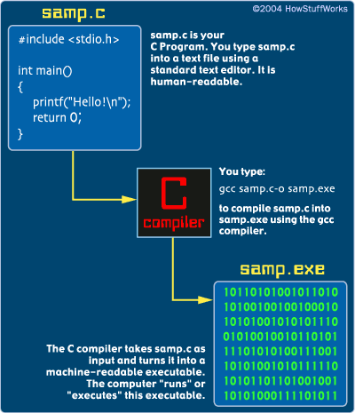
How to compile and run a C program

Slide 19
First C Program
/* First
C
Program*/ /*multi-line comments*/
// A first program in C //Single line comment
#include <stdio.h> //first line of code
main()
{
printf(“Welcome to the world of Programming\n");
}

Slide 20
First C Program
Line 1: #include <stdio.h> (Preprocessor Directive)
This line includes the "standard I/O library" into your program.
The standard I/O library lets you read input from the keyboard (called "standard in"), write output to the screen (called "standard out"), process text files stored on the disk, and so on. It is an extremely useful library.
C has a large number of standard libraries like stdio, including string, time and math libraries.
A library is simply a package of code that someone else has written to make your life easier.
As part of compilation, the C compiler runs a program called the C preprocessor. The preprocessor is able to add and remove code from your source file.
In this case, the directive #include tells the preprocessor to include code from the header file stdio.h.
This file contains declarations for functions that the program needs to use. A declaration for the printf function is in this file.

Slide 21
First C Program
Line 2: void main()
This statement declares the main function.
A C program can contain many functions but must always have one main function.
The parentheses after main indicate that main is a program building block called a function.
A function is a self-contained module of code that can accomplish some task.
Every program in C begins executing at the function main.

Slide 22
First C Program
Line 3: {
A left brace, {, begins the body of every function.
A corresponding right brace } ends each function.

Slide 23
First C Program
Line 4: printf(“Welcome to the world of Programming\n");
printf is a function from a standard C library that is used to print strings to the standard output, normally your screen.
The backslash (\) is called an escape character.
When encountering a backslash in a string, the compiler looks ahead at the next character and combines it with the backslash to form an escape sequence.
The escape sequence \n means newline, causes the cursor to position to the beginning of the next line on the screen.
If there were another printf in this program, its string would print on the next line.

Slide 24
How to excecute the above program:
Inorder to execute the above program, we need to have a compiler to compile and run our programs.
There are certain online compilers like https://ide.geeksforgeeks.org/, http://ideone.com/ or http://codepad.org/ that can be used to start C without installing a compiler.
Windows: There are many compilers available freely for compilation of C programs like Code Blocks and Dev-CPP.
Linux: For Linux, gcc comes bundled with the linux, Code Blocks can also be used with Linux.

Slide 25
The C Character Set
Alphabets A, B, ….., Y, Z
a, b, ……, y, z
Digits 0, 1, 2, 3, 4, 5, 6, 7, 8, 9
Special symbols ~ ‘ ! @ # % ^ & * ( )
_ - + = | \ { } [ ] : ; " ' < > , . ? /

Slide 26
C Tokens
A token is the smallest element of a program that is meaningful to the compiler. Tokens can be classified as follows:
Keywords
Identifiers
Constants
Strings
Special Symbols
Operators

Slide 27
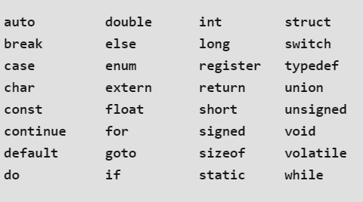
C Keywords
There are certain reserved words, called keywords, that have standard, predefined meanings in C.
These keywords can be used only for their intended purpose; they cannot be used as programmer-defined identifiers.
The keywords cannot be used as variable names.
C supports 32 keywords

Slide 28
IDENTIFIERS
Identifiers are names that are given to various program elements, such as variables, functions and arrays.
Identifiers consist of letters and digits, in any order, except that the first character must be a letter.
Both upper- and lowercase letters are permitted, though common usage favors the use of lowercase letters for most types of identifiers.
Upper- and lowercase letters are not interchangeable (i.e., an uppercase letter is not equivalent to the corresponding lowercase letter.)
The underscore character ( _ ) can also be included, and is considered to be a letter.
An underscore is often used in the middle of an identifier. An identifier may also begin with an underscore, though this is rarely done in practice.

Slide 29
IDENTIFIERS
Valid identifiers
number
year_17
_name
GRADE
DIV_7
Invalid identifiers
123ab
mobile-no.
first name
email@id
Example:
int main()
{
int a=10;
return 0;
}
In this program there are 2 identifiers:
main: method name.
a: variable name.

Slide 30
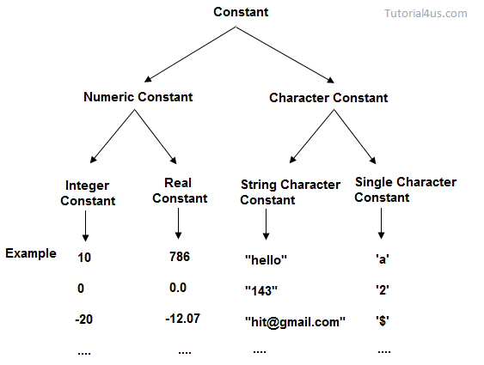
C Constants
It is an identifier whose value can not be changed at the execution time of program. In general constant can be used to represent as fixed values in a C program.
Constants are classified into
following types.
Constants are also called literals.
It is considered best practice to define
constants using only upper-case names.

Slide 31
C Constants
There are two simple ways in C to define constants −
Using #define preprocessor.
Using const keyword.
Syntax-
#define identifier value
Example- #define LENGTH 10
Syntax-
const type variable_name = value;
Example- const int SIDE = 10;

Slide 32
C Constants Example
#include <stdio.h>
#define LENGTH 10
int main()
{
const int WIDTH = 5;
int area;
area = LENGTH * WIDTH;
printf("value of area : %d", area);
return 0;
}

Slide 33
Escape Sequence
Certain nonprinting characters, as well as the backslash (\) and the apostrophe ( ‘ ), can be expressed in terms of escape sequences.
An escape sequence always begins with a backward slash and is followed by one or more special characters.
For example, a line feed (LF), which is referred to as a newline in C, can be represented as \n.
Such escape sequences always represent single characters, even though they are written in terms of two or more characters.
The commonly used escape sequences are listed below.

Slide 34
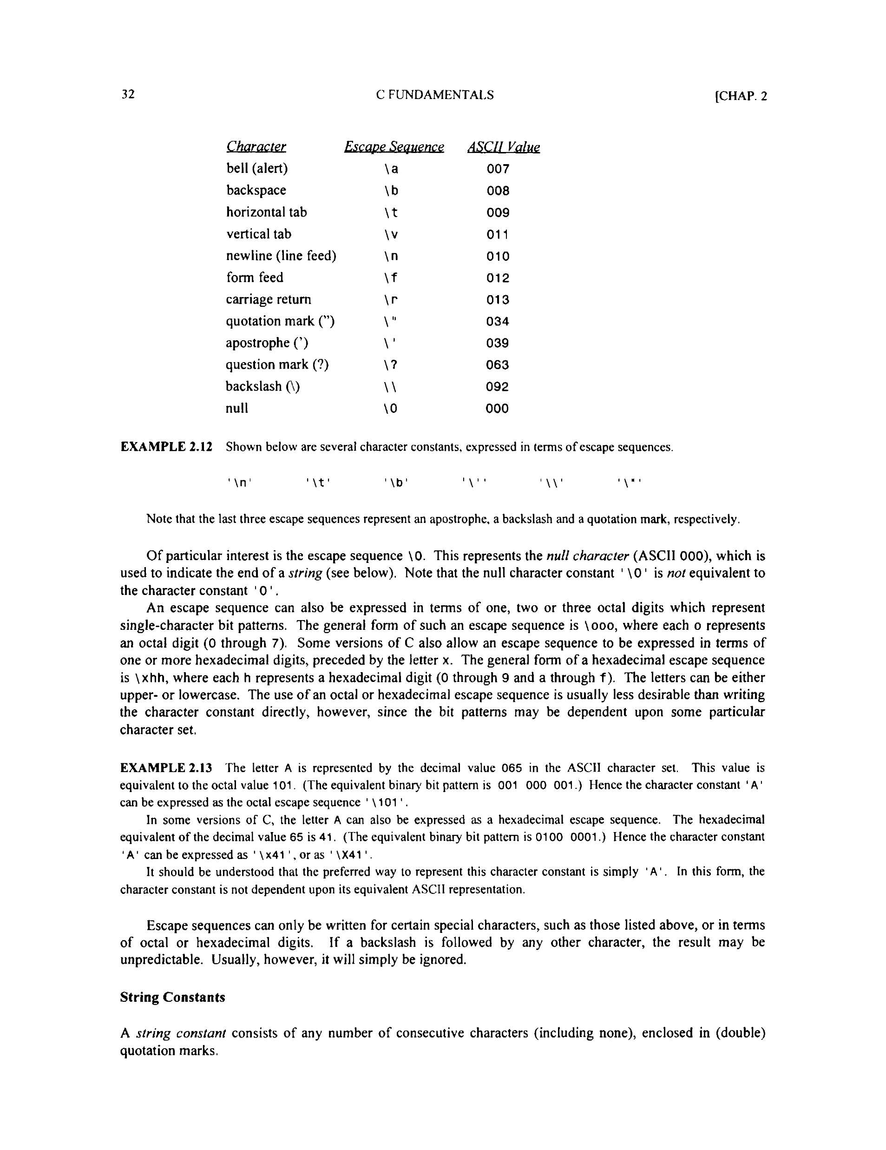
Escape Sequence

Slide 35
Variables in C
Variables are memory locations(storage area) in C programming language.
The main purpose of variables is to store data in memory for later use.
Variables value may change during execution.
If you declare a variable in C, that means you are asking to the operating system for reserve a piece of memory with that variable name.
Each variable in C has a specific type, which determines the size and layout of the variable's memory; the range of values that can be stored within that memory; and the set of operations that can be applied to the variable.
While you can have multiple variables of the same data type, you cannot have multiple variables with the same name.

Slide 36
Variable Declaration in C
A declaration consists of a data type, followed by one or more variable names, ending with a semicolon.
Syntax:
type variable_name;
or
type variable_name, variable_name, variable_name;
Here, type must be a valid C data type including char, int, float, double, or any user-defined object; and variable_name is an identifier name separated by commas.

Slide 37
Variable Declaration in C
C compiler is able to distinguish between the variable names by making it compulsory for you to declare the type of any variable name that you wish to use in a program.
Any variable used in the program must be declared before using it in any statement.
A declaration associates a group of variables with a specific data type.
E.g. int MIS_no;
float marks, percentage;
char grade;

Slide 38
Variable Definition in C
A C program contains the following type declarations.
short int a, b, c;
long int r, s, t;
int p, q;
The above declarations could have been written as
short a, b, c;
long r, s, t ;
int p, q;
Thus, short and short int are equivalent, as are long and long int .

Slide 39
Variable Initialization in C
Initial values can be assigned to variables within a type declaration.
To do so, the declaration must consist of a data type, followed by a variable name, an equal sign (=) and an expression, the expression serves as an initializer. A semicolon must appear at the end.
Syntax:
type variable_name = value;
E.g.
int d = 3, f = 5; // definition and initializing d and f
char x = ‘a'; // the variable x has the value ‘a'.
int c = 12;
float sum = 0.1 ;
double factor = 0.21023e-6; /*factor is a double-precision variable whose initial value is 0.21023 x 10-6 */

Slide 40
Variable in C
A restriction on variables is that variable declarations must come before other types of statements in the given "code block" (a code block is just a segment of code surrounded by { and } ). So in C you must declare all of your variables before you do anything else:
Wrong
#include <stdio.h>
int main()
{
/* wrong! The variable declaration must appear first */
printf("Declare x next" );
int x;
return 0;
}
Fixed
#include <stdio.h>
int main()
{
int x;
printf("Declare x first" );
return 0;
}

Slide 41
Format specifiers
It tells the compiler that which type of value you want to print or read.
Example:
printf(“%d”, a);
Here %d is format specifier and it tells the compiler that we want to print an integer value that is present in variable a.
Format specifier is a special character in the C language used to specify the data type of value.
Format specifiers start with a percentage % operator and followed by a special character for identifying the type of the data.

Slide 42
Format specifiers
Format specifier | Description
%d | Integer Format Specifier
%f | Float Format Specifier
%c | Character Format Specifier
%s | String Format Specifier
%u | Unsigned Integer Format Specifier
%ld | Long Int Format Specifier
Format specifiers are also called as format string.

Slide 43
Data Types in C
The C language has a rich set of data types to handle different kind of data entered by programmer.
Basically a data type informs compiler about how much memory a declared variable required to store input.
Data types are used extensively for declaring variables and functions of different types.

Slide 44
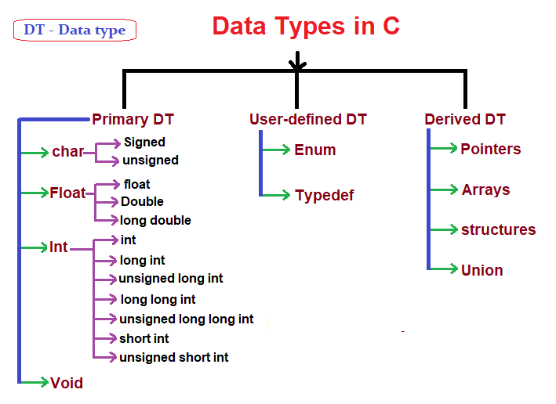

Slide 45
Signed vs Unsigned
The term "unsigned" in computer programming indicates a variable that can hold only positive numbers.
The term "signed" in computer code indicates that a variable can hold negative and positive values.
The property can be applied to most of the numeric data types including int, char, short and long.

Slide 46
Unsigned Variable Type of Integer
An unsigned variable type of int can hold zero and positive numbers, and a signed int holds negative, zero and positive numbers.
In 32-bit integers, an unsigned integer has a range of 0 to 2³²-1 = 0 to 4,294,967,295 or about 4 billion.
The signed version goes from -2³¹-1 to (2³¹ -1 ) which is –2,147,483,648 to 2,147,483,647 or about -2 billion to +2 billion.
An int type in C, C++, and C# is signed by default.
If negative numbers are involved, the int must be signed; an unsigned int cannot represent a negative number.

Slide 47
DATA TYPES
range/values of data types
signed = -2^(n-1) to (2^(n-1))
unsigned = 0 to (2^n) -1

Slide 48
Primary Data Types
Primary data types are those which are already defined in programming languages also known in-built data types.
These data types are basic building blocks of any programming language and numerous composite data types are constructed from this basic type.
We can check the memory size of any variable by using sizeof() operator and a format specifier %lu.

Slide 49
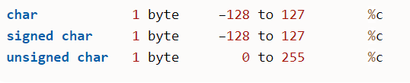
Character Types:
A single character in C is of “char” type data.
Characters stored in 8 bits or 1 byte of memory and the character can also be signed and unsigned.
Signed and unsigned char both used to store single character as per their ASCII values.
For example, ‘A’ will be stored as 65. we don’t need to specify keyword ‘signed’ for using signed char.

Slide 50
Integer Types:
hold only integer values.
stores values in range limited from -2147483648 to 2147483647.
A signed integer uses one bit for sign out of 16 bits.
The integers classified into three classes of storage with both signed and unsigned qualifier based on the range of values held by them.

Slide 51
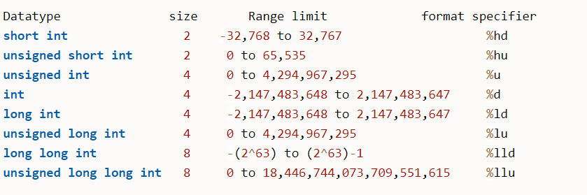

Slide 52
int (1 sign bit + 31 data bits) keyword in C
Example – Consider,
int num=2147483647;
At this point first 2147483647 will be converted into its binary form which is equal to: 1111111111111111111111111111111.
1111111111111111111111111111111 is a 31 digit binary number which will be assigned to variable num’s right most 31 bits and the 32nd bit will have a zero(0) as the number being assigned to variable num is a positive number. If we try to store any number greater than 2147483647 into an ‘int’ type variable then we will lose information.

Slide 53
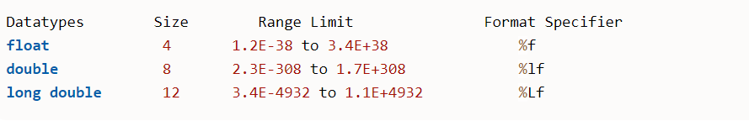
Floating Point Types:
Data type ‘float’ used to stores real numbers in 32 bits with up to 6 decimal points precision.
The double type also similar to float stores in 64 bits with more accurate precision up to 14 decimals and Long double further extends the precision using 80 bits and 19 decimal places.

Slide 54
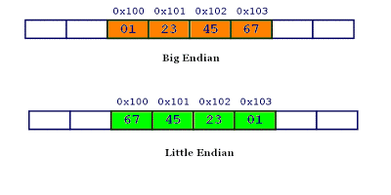
Little and Big Endian
Little and big endian are two ways of storing multibyte data-types ( int, float, etc).
In little endian machines, last byte of binary representation of the multibyte data-type is stored first.
On the other hand, in big endian machines, first byte of binary representation of the multibyte data-type is stored first.
Suppose integer is stored as 4 bytes then a variable x with value 0x01234567 will be stored as following.

Slide 55
printf ()
printf() stands for print formatted string.
printf is a predefined function in "stdio.h" header file, by using this function, we can print the data or user defined message on console or monitor.
Syntax
printf("user defined message");
Syntax
printf("Format specifers",value1,value2,..);
Example:
int a=10;
printf(“%d”, a);
Note- %% Outputs a percent sign.

Slide 56
Mixing Literal Text and Variables Values
We now know that we can output a string literal:
printf("This will be the output \n");
We also know that we can output the value of a variable:
printf("%d", distance);
We can output the values of multiple variables in a single printf():
printf("%d %f", distance, time);
Not surprisingly, we can mix and match the two:
printf(“You are %d miles away\n", distance);
We can even mix and match while outputting the values of multiple variables of various data types:
printf("The %d distance remaining. It will take %f time\n“, distance, time);

Slide 57
printf, sprintf and fprintf
printf(): printf function is used to print character stream of data on stdout console.
Syntax: int printf(const char* str, …)
sprintf(): String print function instead of printing on console store it on char buffer which are specified in sprintf
Syntax: int sprintf(char* str, const char *string,…)
fprint():fprintf is used to print the string content in file but not on stdout console.
Syntax: int fprintf(FILE* fptr, const char *str,…)

Slide 58
scanf()
scanf() stands for scan formatted string.
scanf() is a predefined function in "stdio.h" header file.
It is used to read the input value from the keyword.
Syntax
scanf("format specifiers",&value1,&value2,.....);
E.g.
int var;
scanf("%d",&var);
The address-of operator (&) preceding a variable i.e. &var indicates the memory location of variable 'var'.
Note- For using I/O functionality, programmers must include stdio header-file within the program.

Slide 59
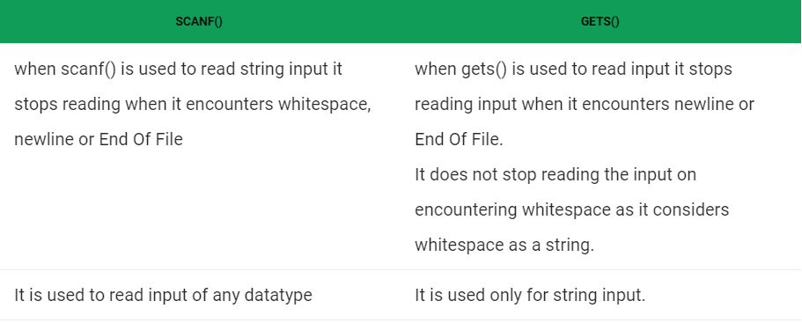
scanf() vs gets()

Slide 60
getc(), getchar(), getch() and getche()
All of these functions read a character from input and return an integer value.
The integer is returned to accommodate a special value used to indicate failure.
The value EOF is generally used for this purpose.
getc(): It reads a single character from a given input stream and returns the corresponding integer value (typically ASCII value of read character) on success. It returns EOF on failure.
Syntax: int getc(FILE *stream)
getchar(): The difference between getc() and getchar() is getc() can read from any input stream, but getchar() reads from standard input. So getchar() is equivalent to getc(stdin).
int getchar(void)
getche(): Like getch(), this is also a non-standard function present in conio.h. It reads a single character from the keyboard and displays immediately on output screen without waiting for enter key.
int getche(void)

Slide 61
C Operators
C operators are symbols that are used to perform mathematical or logical manipulations.
C programming language is rich with built-in operators. Operators take part in a program for manipulating data and variables and form a part of the mathematical or logical expressions.
The data items that operators act upon are called operands. Some operators require two operands, while others act upon only one operand.
Types of Operators in C:
Arithmetic Operators
Relational Operators
Logical Operators
Assignment Operators
Increment and Decrement Operators
Conditional Operator
Bitwise Operators
Special Operators

Slide 62
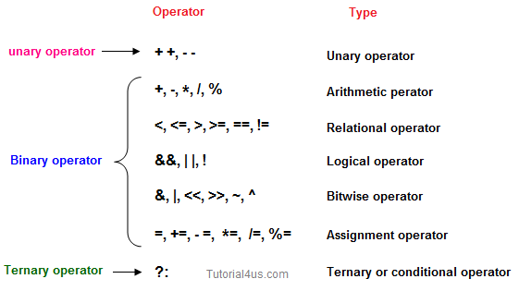
C Operators

Slide 63
Arithmetic Operators
There are five arithmetic operators in C. They are
Operator Description
+ addition
- subtraction
* multiplication
I division
% remainder after integer division
The % operator is sometimes referred to as the modulus operator.
The remainder operator (%) requires that both operands be integers and the second operand be nonzero. Similarly, the division operator (/) requires that the second operand be nonzero.
The %operator cannot be applied to float or double.

Slide 64
Arithmetic Operators
Division of one integer quantity by another may results in a truncated quotient (i.e., the decimal portion of the quotient will be dropped).
On the other hand, if a division operation is carried out with two floating-point numbers, or with one floating-point number and one integer, the result will be a floating-point quotient.
There is no exponentiation operator in C. However, there is a library function (POW) to carry out exponentiation .
The direction of truncation for I and the sign of the result for % are machine-dependent for negative operands.
The interpretation of the remainder operation is unclear when one of the operands is negative. Most versions of C assign the sign of the first operand to the remainder.
If one or both operands represent negative values, then the addition, subtraction, multiplication and division operations will result in values whose signs are determined by the usual rules of algebra.

Slide 65
Arithmetic Operators
suppose that c1 and c2 are character-type variables that represent the characters P and T, respectively.
Few arithmetic expressions that make use of these variables are shown below, together with their resulting values (based upon the ASCII character set).
c1 + c2 164
c1 + c2 + 5 169
Note that P is encoded as (decimal) 80, T is encoded as 84, in the ASCII character set, as shown in Table.

Slide 66
Increment and Decrement Operators
The increment operator ++ adds 1 to its operand, while the decrement operator -- subtracts 1 i.e. ++x & x++ means x=x+1 or --x & x-- means x=x-1.
But there is a slight difference between ++ or -- written before or after the operand.
(Pre)If the operator precedes the operand (e.g., ++i), then the operand will be altered in value before it is utilized for its intended purpose.
(Post)If, however, the operator follows the operand (e.g., i++), then the value of the operand will be altered after it is utilized.
Operator | Description
++ | Increment
−− | Decrement

Slide 67
Increment and Decrement Operators
Applying the pre-increment first add one to the operand and then the result is assigned to the variable on left where as post-increment first assigns the value to the variable on left and then increment the operand.
The expression ++n increments n before its value is used, while n++ increments n after its value has been used.
If n is 5, then
x = n++;
sets x to 5, but
x = ++n;
sets x to 6.
The increment and decrement operators can only be applied to variables; an expression like ( i + j ) + + is illegal.

Slide 68
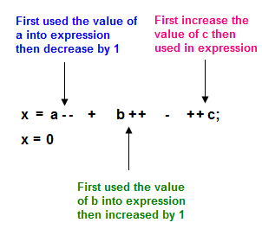
Increment and Decrement Operators
Example of increment and decrement operator
void main()
{
int x, a, b, c;
a = 2;
b = 4;
c = 5;
x = a-- + b++ - ++c;
printf("x: %d",x);
}

Slide 69
Increment and Decrement Operators
A C program includes an integer variable i whose initial value is 1. Suppose the program includes the following three printf statements.
printf ("i = %d\n" , i);
printf("i = %d\n", i++);
printf("i = %d\n", i);
These statements will generate the following three lines of output.
i = 1
i = 1
i = 2

Slide 70
Relational Operators
Relational operators are used to compare two quantities or values.
Relational operators in C are given in table on next slide:
These six operators are used to form logical expressions, which represent conditions that are either true or false.
The resulting expressions will be of type integer, since true is represented by the integer value 1 and false is represented by the value 0.

Slide 71
Relational Operators
Assume variable
A holds 10 and
variable B holds
20 then:
int A=10;
int B=20;
int x;
x= (A==B);
Operator | Description | Example
== | Checks if the values of two operands are equal or not. If yes, then the condition becomes true. | (A == B) is not true.
!= | Checks if the values of two operands are equal or not. If the values are not equal, then the condition becomes true. | (A != B) is true.
> | Checks if the value of left operand is greater than the value of right operand. If yes, then the condition becomes true. | (A > B) is not true.
< | Checks if the value of left operand is less than the value of right operand. If yes, then the condition becomes true. | (A < B) is true.
>= | Checks if the value of left operand is greater than or equal to the value of right operand. If yes, then the condition becomes true. | (A >= B) is not true.
<= | Checks if the value of left operand is less than or equal to the value of right operand. If yes, then the condition becomes true. | (A <= B) is true.

Slide 72
Relational Operators
EXAMPLE- Suppose that i,j and k are integer variables whose values are 1, 2 and 3, respectively.
Expression Interpretation Value
i < j true 1
(1 + j) >= k true 1
(j + k) > (i + 5) false 0
k ! = 3 false 0
j == 2 true 1

Slide 73
Logical Operators
C provides three logical operators when we test more than one condition to make decisions.
These are: && (meaning logical AND), || (meaning logical OR) and ! (meaning logical NOT).
The logical operators act upon operands that are themselves logical expressions.
The net effect is to combine the individual logical expressions into more complex conditions that are either true or false.
In this context it should be pointed out that any nonzero value, not just 1, is interpreted as true.

Slide 74
Logical Operators
Assume variable A holds 1 and variable B holds 0, then −
Operator | Description | Example
&& | Called Logical AND operator. If both the operands are non-zero, then the condition becomes true. | (A && B) is false.
|| | Called Logical OR Operator. If any of the two operands is non-zero, then the condition becomes true. | (A || B) is true.
! | Called Logical NOT Operator. It is used to reverse the logical state of its operand. If a condition is true, then Logical NOT operator will make it false. | !(A && B) is true.

Slide 75
Logical Operators
Operands |  | Results
x | y | x && y | x || y
0 | 0 | 0 | 0
0 | non-zero | 0 | 1
non-zero | 0 | 0 | 1
non-zero | non-zero | 1 | 1

Slide 76
Logical Operators
Example- Suppose that i is an integer variable whose value is 7, f is a floating-point variable whose value is 5.5 and c is a character variable that represents the character ‘ w’ .
Expression Interpretation Value
(i >= 6) && (c == ' w ' ) true 1
(i >= 6) || (c == 119) true 1
(f < 11) && (i > 100) false 0
(c != ' p ' ) || ((i + f ) <= 10) true 1
E.g. 5 && i != 8
The result of a logical and operation will be true only if both operands are true, whereas the result of a logical or operation will be true if either operand is true or if both operands are true. In other words, the result of a logical or operation will be false only if both operands are false.

Slide 77
Bitwise Operators
Bitwise operator works on bits and perform bit-by-bit operation. C provides six operators for bit manipulation.
Assume variable
'A' holds 60 and
variable 'B' holds 13,
then −
60 - 00111100
13- 00001101
Operator | Description | Example
& | Binary AND Operator copies a bit to the result if it exists in both operands. | (A & B) = 12, i.e., 0000 1100
| | Binary OR Operator copies a bit if it exists in either operand. | (A | B) = 61, i.e., 0011 1101
^ | Binary XOR Operator copies the bit if it is set in one operand but not both. | (A ^ B) = 49, i.e., 0011 0001
~ | Binary Ones Complement Operator is unary and has the effect of 'flipping' bits. | (~A ) = -61, i.e,. 1100 0011 in 2's complement form.
<< | Binary Left Shift Operator. The left operands value is moved left by the number of bits specified by the right operand. | A << 2 = 240 i.e., 1111 0000
>> | Binary Right Shift Operator. The left operands value is moved right by the number of bits specified by the right operand. | A >> 2 = 15 i.e., 0000 1111

Slide 78
Assignment Operators
There are several different assignment operators in C.
All of them are used to form assignment expressions, which assign the value of an expression to an identifier.
Assignment operators applied to assign the result of an expression to a variable.

Slide 79
Assignment Operators
Operator | Description | Example
= | Simple assignment operator. Assigns values from right side operands to left side operand | C = A + B will assign the value of A + B to C
+= | Add AND assignment operator. It adds the right operand to the left operand and assign the result to the left operand. | C += A is equivalent to C = C + A
-= | Subtract AND assignment operator. It subtracts the right operand from the left operand and assigns the result to the left operand. | C -= A is equivalent to C = C - A
*= | Multiply AND assignment operator. It multiplies the right operand with the left operand and assigns the result to the left operand. | C *= A is equivalent to C = C * A
/= | Divide AND assignment operator. It divides the left operand with the right operand and assigns the result to the left operand. | C /= A is equivalent to C = C / A
%= | Modulus AND assignment operator. It takes modulus using two operands and assigns the result to the left operand. | C %= A is equivalent to C = C % A
<<= | Left shift AND assignment operator. | C <<= 2 is same as C = C << 2
>>= | Right shift AND assignment operator. | C >>= 2 is same as C = C >> 2
&= | Bitwise AND assignment operator. | C &= 2 is same as C = C & 2
^= | Bitwise exclusive OR and assignment operator. | C ^= 2 is same as C = C ^ 2
|= | Bitwise inclusive OR and assignment operator. | C |= 2 is same as C = C | 2

Slide 80
Assignment Operators
If expr 1 and expr 2 are expressions, then
expr1 op = expr 2
is equivalent to
expr1 = (expr 1 ) op (expr 2 )
operator op =, where op is one of + - * I & % << >>
Notice the parentheses around expr2
E.g.: x *= y + 1
means
x= x* (y + 1)
rather than
x = x * y + 1

Slide 81
Conditional Operator
It is a ternary operator (?:) to construct conditional expressions.
Such an expression can be written in place of the more traditional if -else statement
A conditional expression is written in the form
expression 1 ? expression 2 : expression 3
When evaluating a conditional expression, expression 1 is evaluated first. If expression 1 is true (i.e., if its value is nonzero), then expression 2 is evaluated and this becomes the value of the conditional expression. However, if expression 1 is false (i.e., if its value is zero), then expression 3 is evaluated and this becomes the value of the conditional expression.
Note that only one of the embedded expressions (either expression 2 or expression 3) is evaluated when determining the value of a conditional expression.

Slide 82
Conditional Operator
Example- In the conditional expression shown below, assume that i is an integer variable.
(i < 0) ? 0 : 100
The expression (i < 0) is evaluated first. If it is true (i.e., if the value of i is less than 0), the entire conditional expression takes on the value 0. Otherwise (if the value of i is not less than 0),the entire conditional expression takes on the value 100.

Slide 83
Conditional Operator
#include <stdio.h>
int main()
{
int a = 4;
int b;
/* example of ternary operator */
a = 10;
b = (a == 1) ? 20: 30;
printf( "Value of b is %d\n", b );
return 0;
}
Value of b is 30

Slide 84
Special Operators
sizeof(): This operator returns the size of its operand, in bytes.
The sizeof operator always precedes its operand.
The sizeof operator is used to calculate the size of data type or variables.
Syntax
sizeof(variable)
For example: sizeof(a), where a is a character, will return 1.

Slide 85
sizeof() operator
#include <stdio.h>
void main()
{
int a = 4;
short b;
double c;
/* example of sizeof operator */
printf("Line 1 - Size of variable a = %d\n", sizeof(a) );
printf("Line 2 - Size of variable b = %d\n", sizeof(b) );
printf("Line 3 - Size of variable c= %d\n", sizeof(c) );
}

Slide 86
Precedence and Associativity of Operators
Operator precedence determines which operator is performed first in an expression with more than one operators with different precedence.
For example 10 + 20 * 30 is calculated as 10 + (20 * 30) and not as (10 + 20) * 30.
Associativity is used when two operators of same precedence appear in an expression. Associativity can be either Left to Right or Right to Left.
For example ‘*’ and ‘/’ have same precedence and their associativity is Left to Right, so the expression “100 / 10 * 10” is treated as “(100 / 10) * 10”.
Precedence and Associativity are two characteristics of operators that determine the evaluation order of sub-expressions in absence of brackets.

Slide 87
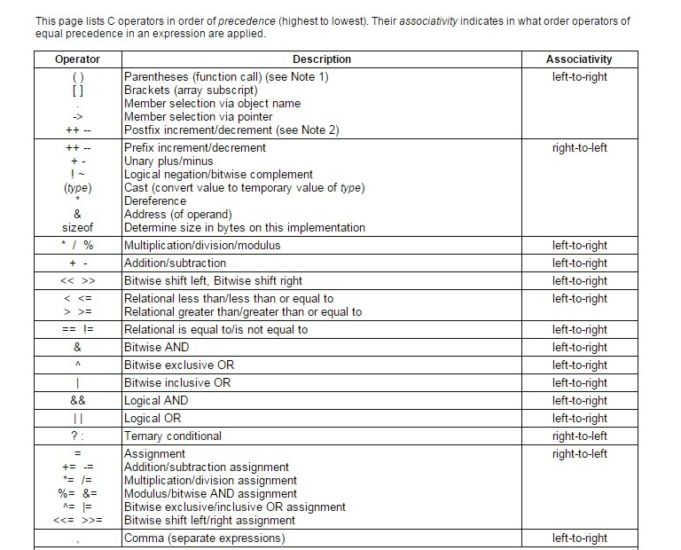

Slide 88
Example
Algebra:
a(b+c)+ c(d+e)
C:
a * ( b + c ) + c * ( d + e ) ;
Precedence:
3 1 5 4 2

Slide 89
Examples
Example 1: Determine the hierarchy of operations and evaluate the following expression, assume i is of type int:
i = 2 * 3 / 4 + 4 / 4 + 8 - 2 + 5 / 8
Example 2: Determine the hierarchy of operations and evaluate the following expression, assume kk is a float:
kk = 3 / 2 * 4 + 3 / 8 + 3

Slide 90
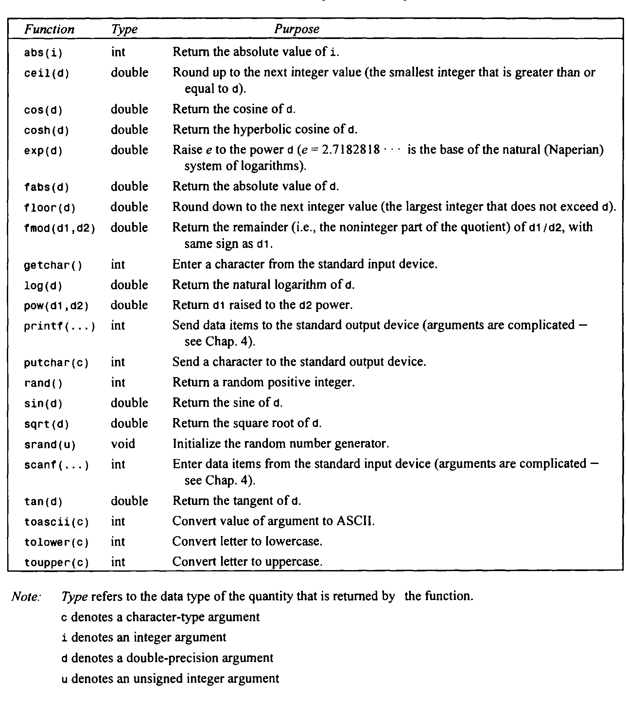
C Library Functions

Slide 91
Type Casting
Type casting is a way to convert a variable from one data type to another data type.
For example, if you want to store a 'long' value into a simple integer then you can type cast 'long' to 'int'.
You can convert the values from one type to another explicitly using the cast operator as follows −
(type_name) expression
It’s best practice to convert lower data type to higher data type to avoid data loss.

Slide 92
Type Casting
#include <stdio.h>
void main()
{
int sum = 17, count = 5;
double mean;
mean = (double) sum / count;
printf("Value of mean : %f\n", mean);
}
Output- Value of mean : 3.400000

Slide 93
Type Conversion
Type conversions can be implicit which is performed by the compiler automatically, or it can be specified explicitly through the use of the cast operator.
It is considered good programming practice to use the cast operator whenever type conversions are necessary.
type of the expression and the type of the variable on the left-hand side of the assignment operator (=) may not be same.
value of the expression is promoted or demoted depending on the type of the variable on left-hand side of =.

Slide 94
Type Conversion
Examples:
int i;
float b;
i=3.5;
b=30;
float a, b, c ;
int s ;
s = a * b * c / 100 + 32 / 4 - 3 * 1.1;

Slide 95
Integer Promotions in C
Integer promotion is the process by which values of integer type "smaller" than int or unsigned int are converted either to int or unsigned int.
Some data types like char, short int take less number of bytes than int, these data types are automatically promoted to int or unsigned int when an operation is performed on them. This is called integer promotion.
For example no arithmetic calculation happens on smaller types like char, short. They are first converted to int or unsigned int, and then arithmetic is done on them.
If an int can represent all values of the original type, the value is converted to an int .
Otherwise, it is converted to an unsigned int.

Slide 96
Integer Promotions in C
#include <stdio.h>
int main()
{
int i = 17;
char c = 'c'; /* ascii value is 99 */
int sum;
sum = i + c;
printf("Value of sum : %d\n", sum );
return 0;
}
Value of sum : 116
because the compiler is doing integer promotion and converting the value of 'c' to ASCII before performing the actual addition operation.

Slide 97
Integer Promotions in C
#include <stdio.h>
int main()
{
char a = 30, b = 40, c = 10;
char d = (a * b) / c;
printf ("%d ", d);
return 0;
}
Output: 120
At first look, the expression (a*b)/c seems to cause arithmetic overflow because signed characters can have values only from -128 to 127 (in most of the C compilers), and the value of sub-expression ‘(a*b)’ is 1200 which is greater than 128. But integer promotion happens here in arithmetic done on char types and we get the appropriate result without any overflow.

Slide 98
Type Conversion
In general, if an operator like + or * that takes two operands (a binary operator) has operands of different types, the "lower" type is promoted to the "higher" type before the operation proceeds.
The result is of the higher type.

Slide 99
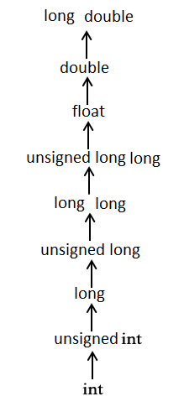
Usual Arithmetic Conversion
The usual arithmetic conversions are implicitly performed to cast their values to a common type.
The compiler first performs integer promotion; if the operands still have different types, then they are converted to the type that appears highest in the following hierarchy −
Note- The usual arithmetic conversions are not performed for the assignment operators, nor for the logical operators && and ||.

Slide 100
Example
Suppose that i is an integer variable whose value is 7, f is a floating-point variable whose value is 5.5, and c is a character-type variable that represents the character w
Each expression involves operands of two different types. Assume that the ASCII character set is being used.
Expression Value Type
i + f 12.5 float
i + c 126 integer
i + c - ’0' 78 integer
(i + c) - (2 * f / 15 ) 123.8 float
Note that w is encoded as (decimal) 119 and 0 is encoded as 48 in the ASCII character set.

Slide 101
FEW CONVERSION RULES
1. If both operands are floating-point types whose precisions differ (e.g., a float and a double), the lower precision operand will be converted to the precision of the other operand, and the result will be expressed in this higher precision. Thus, an operation between a f l o a t and a double will result in a double; a f l o a t and a long double will result in a long double; and a double and a long double will result in a long double. (Note: In some versions of C, all operands of type float are automatically converted to double.)
2. If one operand is a floating-point type (e.g., float , double or long double) and the other is a char or an i n t (including short i n t or long int), the char or i n t will be converted to the floating-point type and the result will be expressed as such. Hence, an operation between an i n t and a double will result in a double.
3. If neither operand is a floating-point type but one is a long int , the other will be converted to long i n t and the result will be long int . Thus, an operation between a long i n t and an i n t will result in along i n t .
4. If neither operand is a floating-point type or a long int , then both operands will be converted to int (if necessary) and the result will be int . Thus, an operation between a short int and an int will result in an int.
Note- There may be some variation from one version of C to another.

Slide 102
CONVERSION RULES
These rules apply to arithmetic operations between two operators with dissimilar data types. There may be some variation
from one version of C to another.
1. If one of the operands is long double, the other will be converted to long double and the result will be long
double.
2. Otherwise, if one of the operands is double, the other will be converted to double and the result will be double.
3. Otherwise, if one of the operands is f l o a t , the other will be converted to f l o a t and the result will be f l o a t
4. Otherwise, if one of the operands is unsigned long i n t , the other will be converted to unsigned long i n t and
the result will be unsigned long i n t .
5. Otherwise, if one of the operands is long i n t and the other is unsigned i n t , then:
(a) If unsigned i n t can be converted to long i n t , the unsigned i n t operand will be converted as such and
the result will be long i n t .
(b) Otherwise, both operands will be converted to unsigned long i n t and the result will be unsigned long
i n t .
6. Otherwise, if one of the operands is long i n t , the other will be converted to long i n t and the result will be long
i n t .
7. Otherwise, if one of the operands is unsigned i n t , the other will be converted to unsigned i n t and the result
will be unsigned i n t .
8. If none of the above conditions applies, then both operands will be converted to i n t (if necessary), and the result
will be i n t .

